Slide 1
JOURNEY PPT Technical Onboarding - Week 6 Custom IDA Bootcamp
Afrin Siddiqui – IDA
Supervisory Organization: PTIY/FBD CC HR and Corporate (Pankaj Janak Kumar) (59726509)
Position Title: 54077724 Associate Data Engineer
Location: Bangalore RMZ-ECO WORLD
Employee ID: 654991

Slide 2
Day 1 – Azure DataBricks
Learned about the working of ADB as a unified, open analytics platform for building, deploying, sharing, and maintaining enterprise-grade data, analytics, and AI solutions at scale.
Understood how to run Azure SQL queries on Azure Data Lake.
Ingest into Azure through Azure Data Factory in batches
Stream real-time by using Apache Kafka, Event Hubs, or IoT Hub

Slide 3
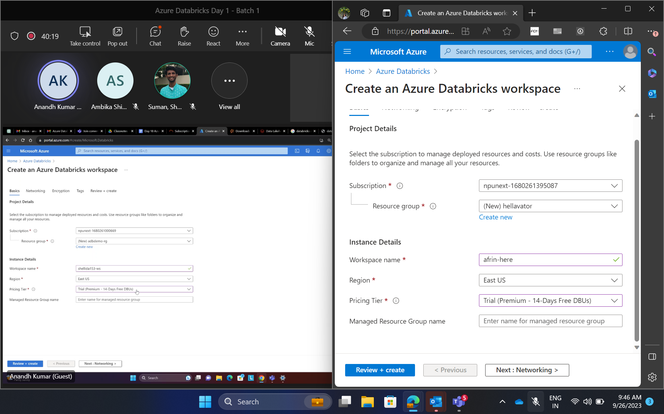
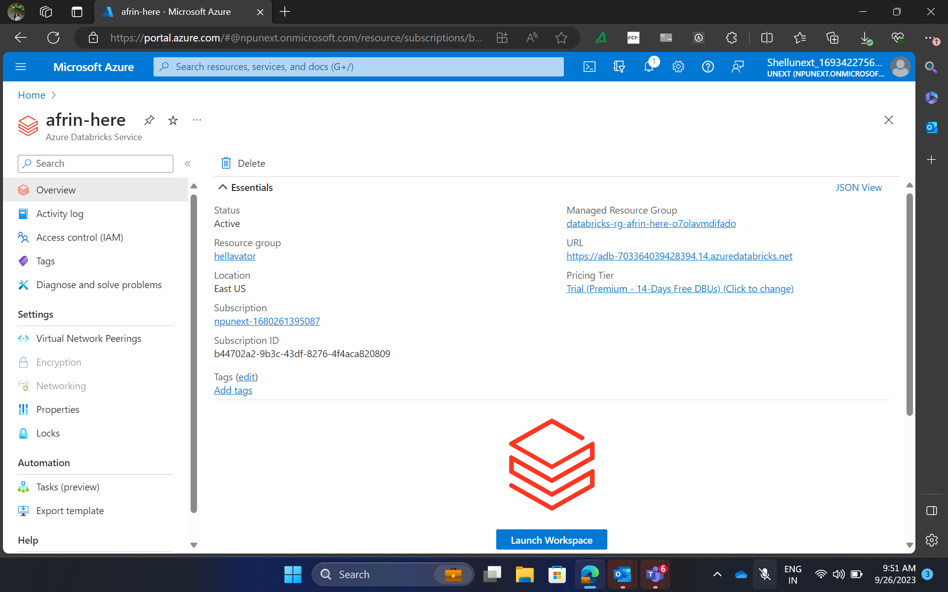
Day 1– (Online)Hands on training/ Practical Work

Slide 4
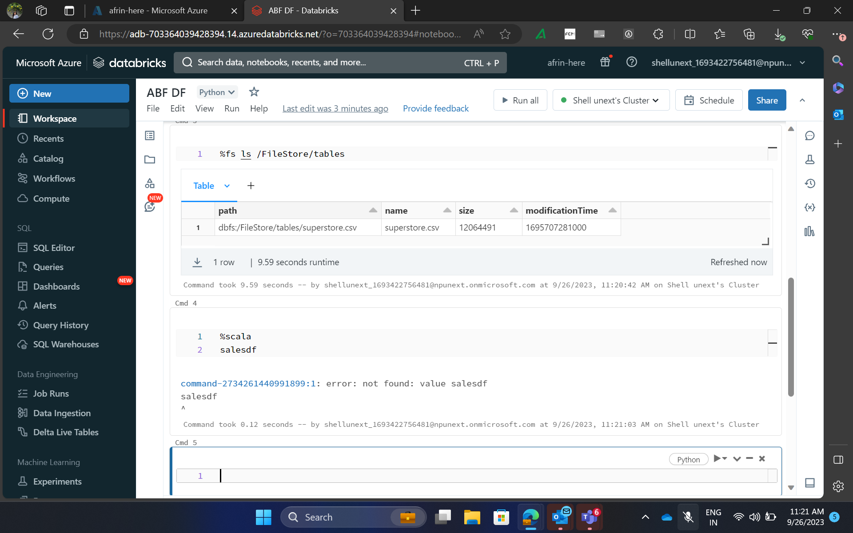
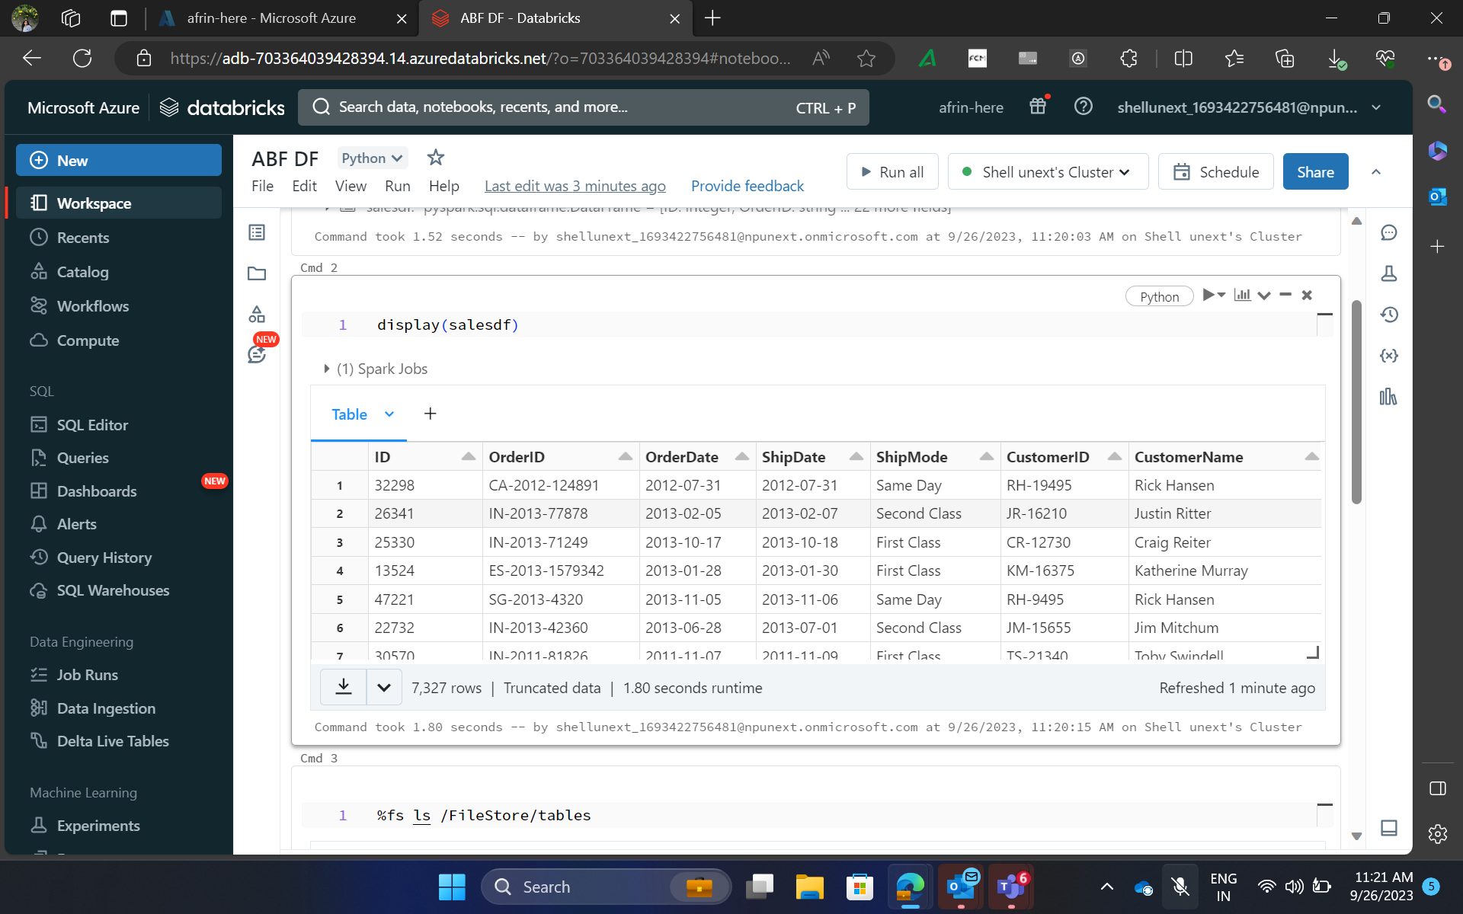
Day 1– (Online)Hands on training/ Practical Work

Slide 5
Day 2 – Azure Databricks Cont.
Learned about the storage system in ADB and it maintains big data.
Data Management
Databricks File System (DBFS): It is an abstraction layer over the Blob store. It contains directories that can contain files or more directories.
Database: It is a collection of information that can be managed and updated.
Table: Tables can be queried with Apache Spark SQL and Apache Spark APIs.
Metastore: It stores information about various tables and partitions in the data warehouse.

Slide 6
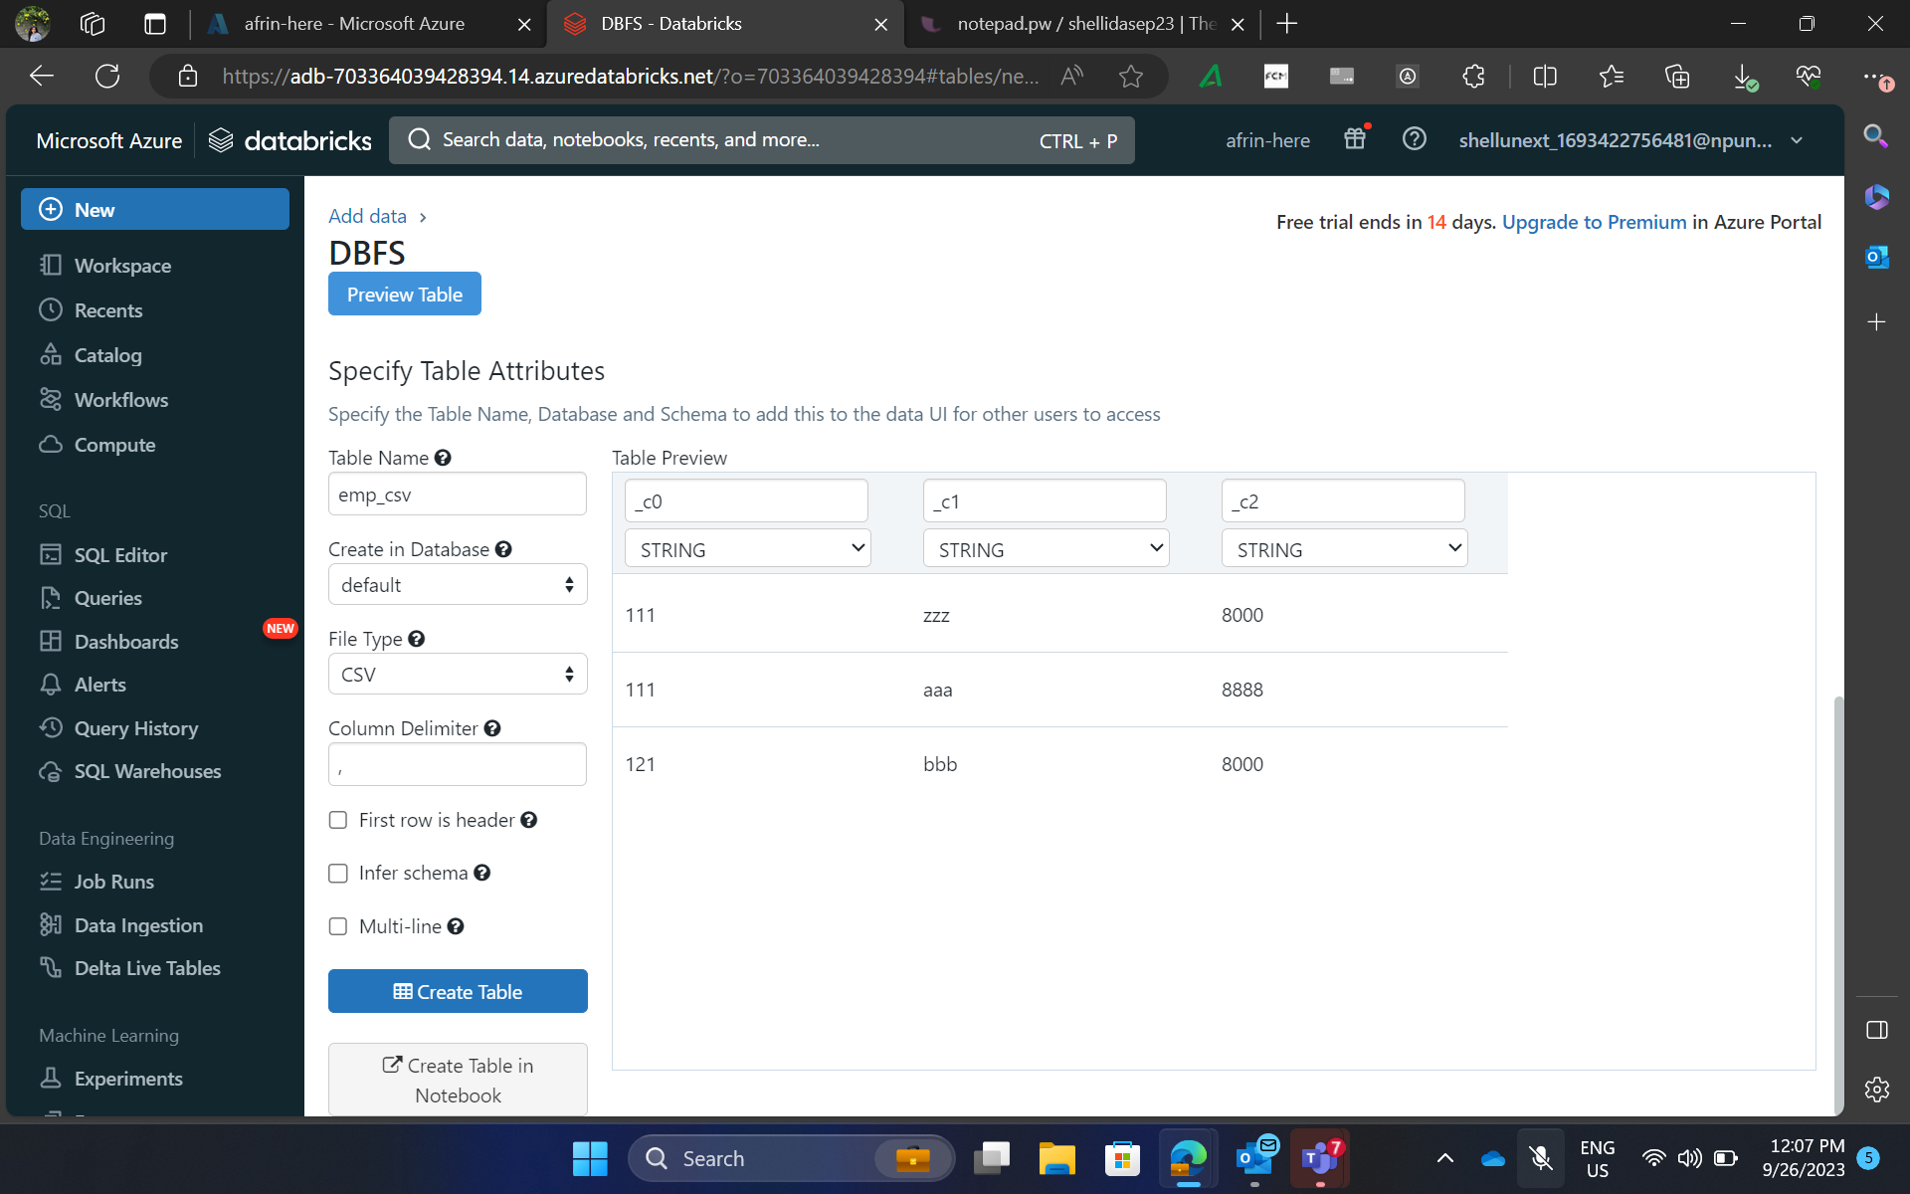
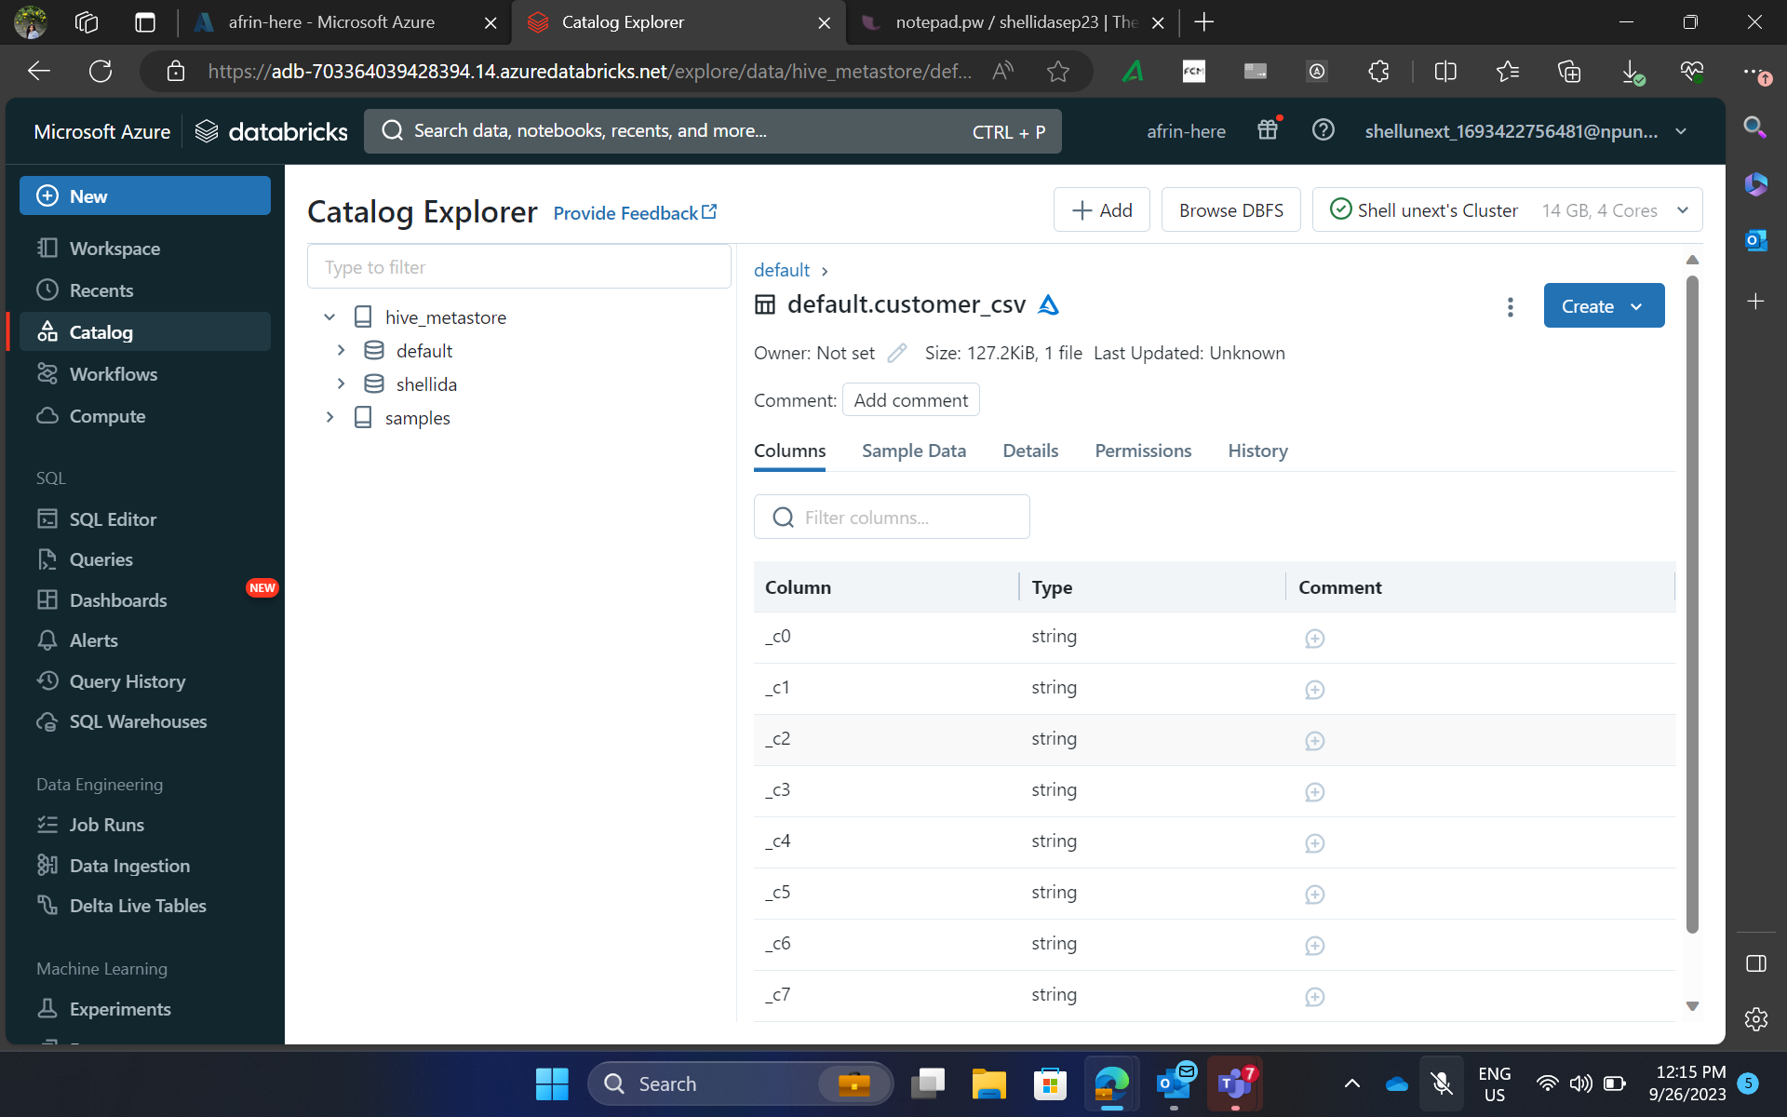
Day 2 – Hands on training/ Practical Work

Slide 7
Day 3 – Data Engineering with ADB
Worked in on real – time dataset and performed data analysis to extract actionable insights.
Learned how to run jobs in DBFS
Cluster: It is a set of computation resources and configurations on which we can run notebooks and jobs. These are of two types:
All-purpose: We create an all-purpose cluster by using UI, CLI, or REST API. We can manually terminate and restart an all-purpose cluster. Multiple users can share such clusters to do collaborative, interactive analysis.
Job: The Azure Databricks job scheduler creates a job cluster when we run a job on a new job cluster and terminates the cluster when the job is complete. We cannot restart a job cluster.
Worked with Azure Blobs/ADLS for data ingestion.
Concept of Batch vs Streaming data.

Slide 8
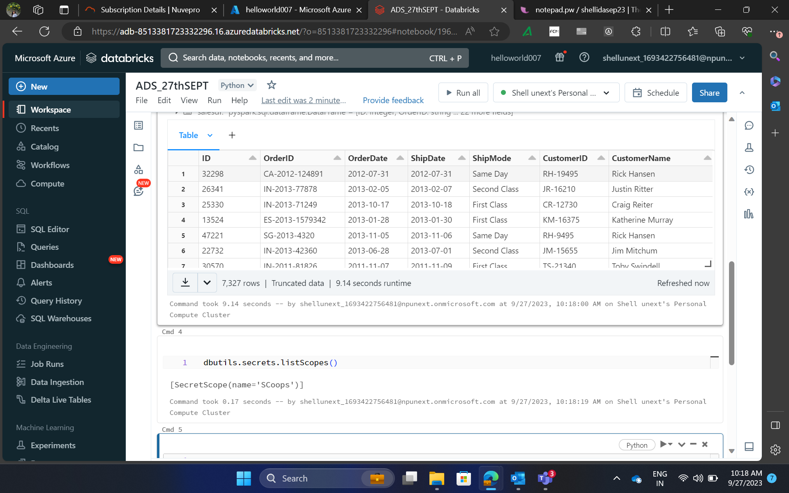
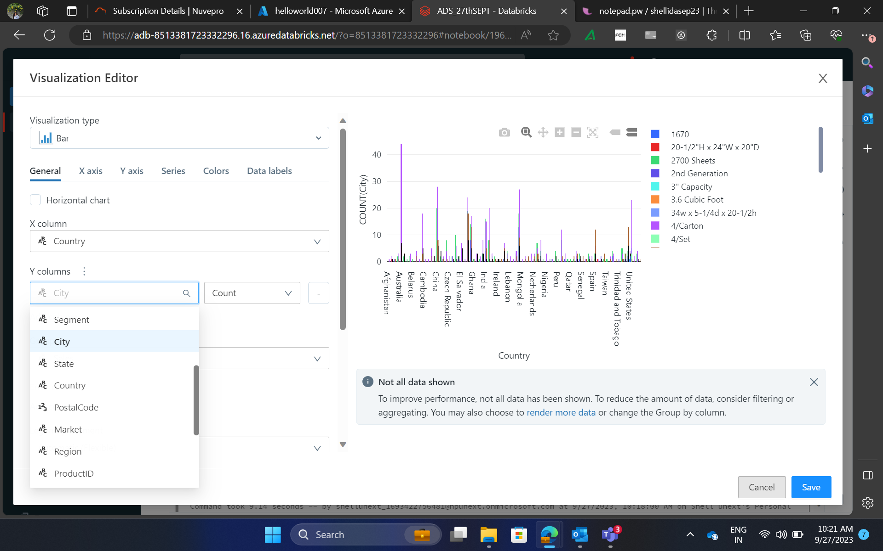
Day 3 – Hands on training/ Practical Work

Slide 9
Day 4 – Virtualization_Evolution of Cloud
Did hands on practicals of Azure Databricks bricks using different datasets.
Utilised remote desktops to run ML jobs

Slide 10
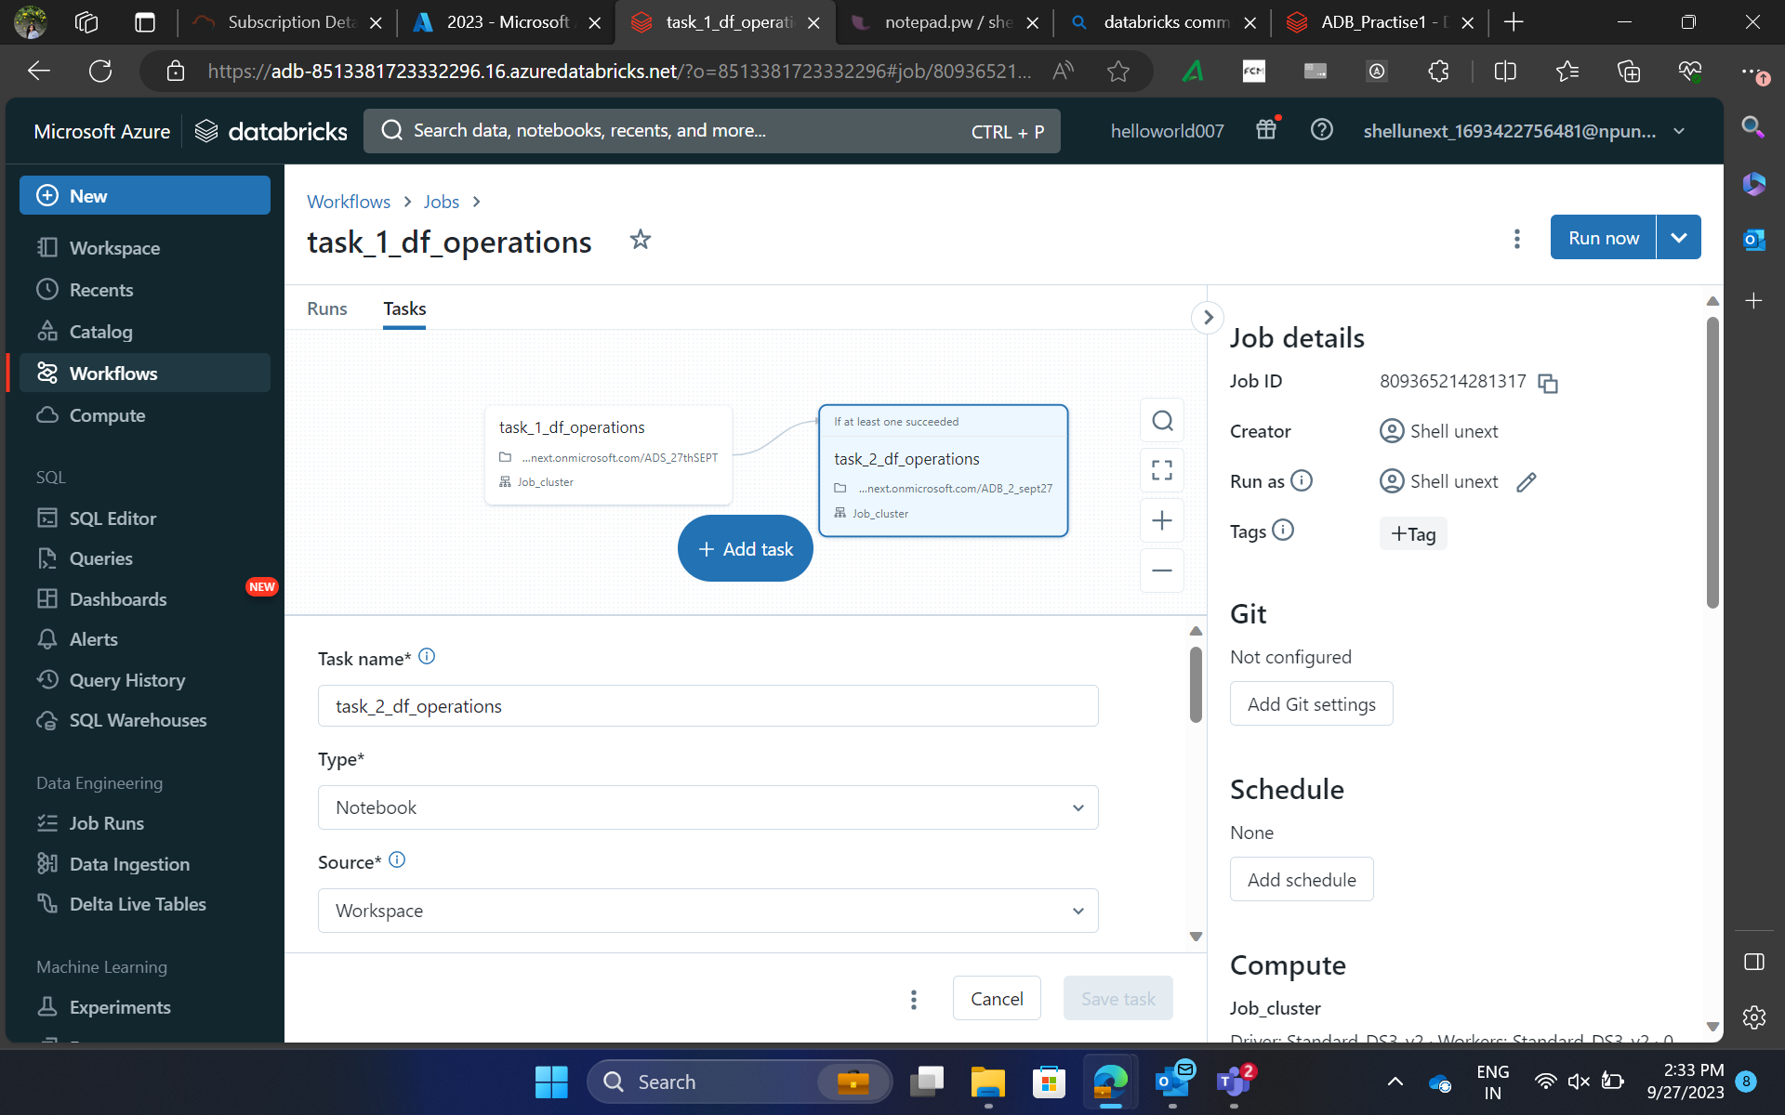
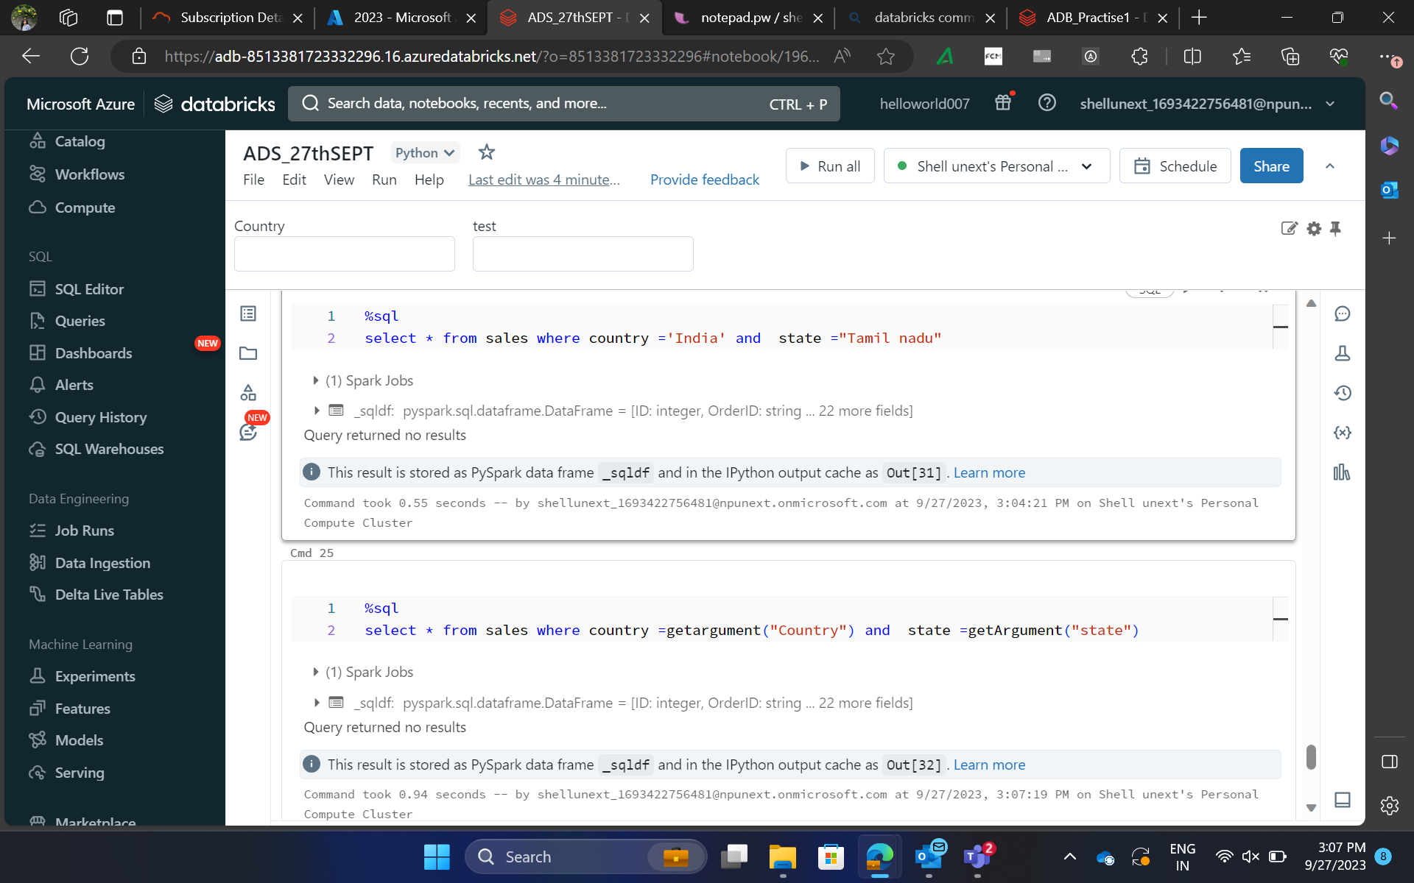
Day 4 – Hands on training/ Practical Work

Slide 11
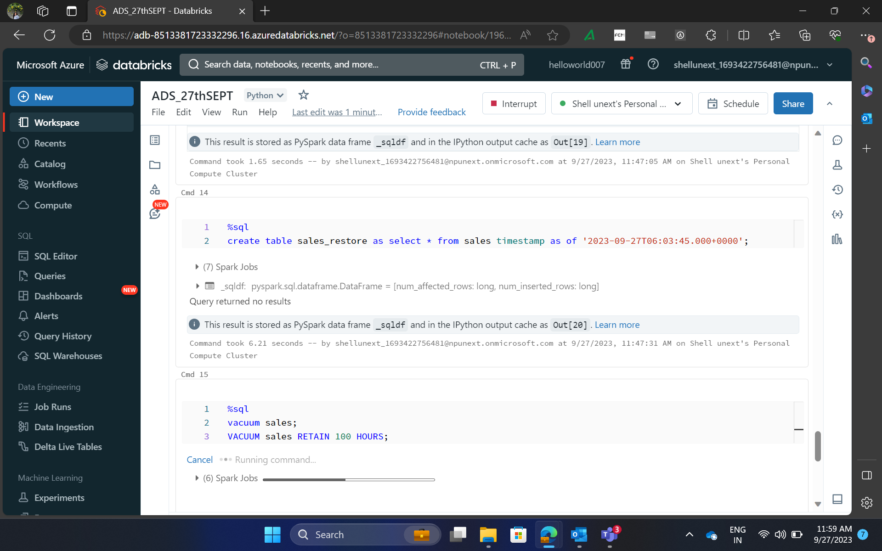
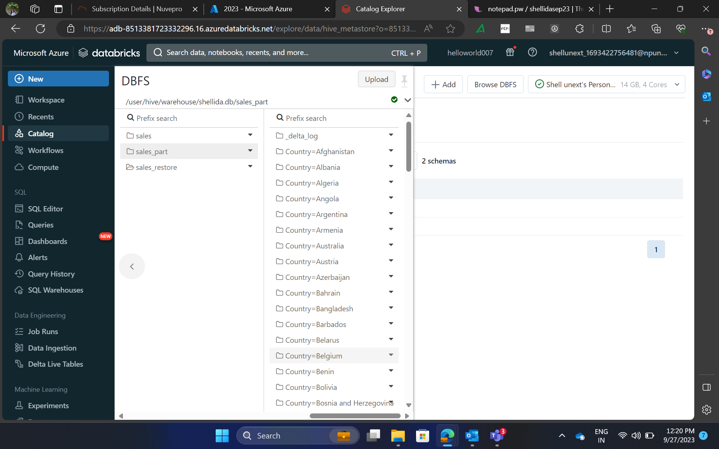
Day 4 – Hands on training/ Practical Work

Slide 12
Day 5 – Introduction to Kubernetes
Understood the new-age technology of Kubernetes and how it hosts containers, pods and services.
Learned how to create and run containers on Docker.

Slide 13
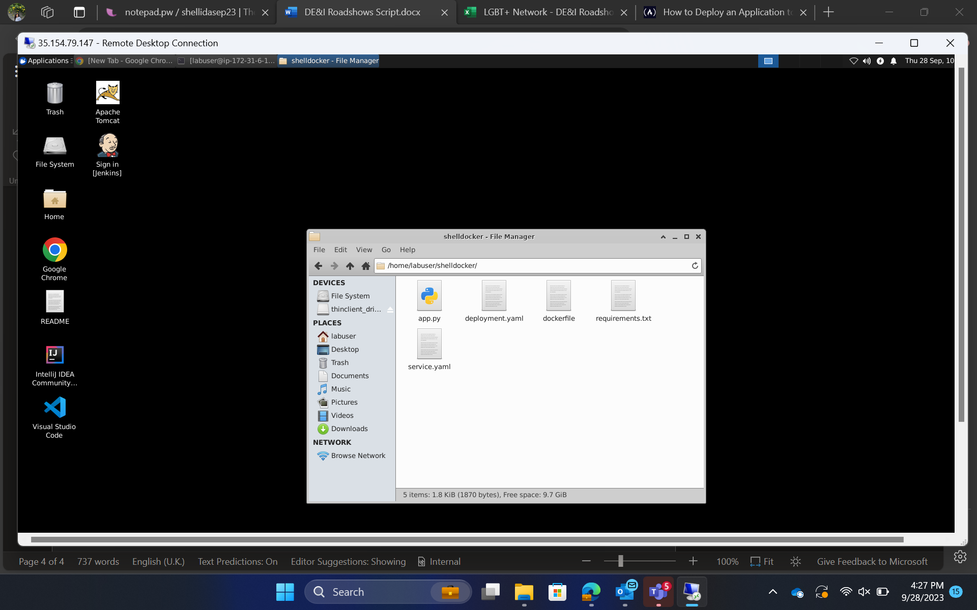
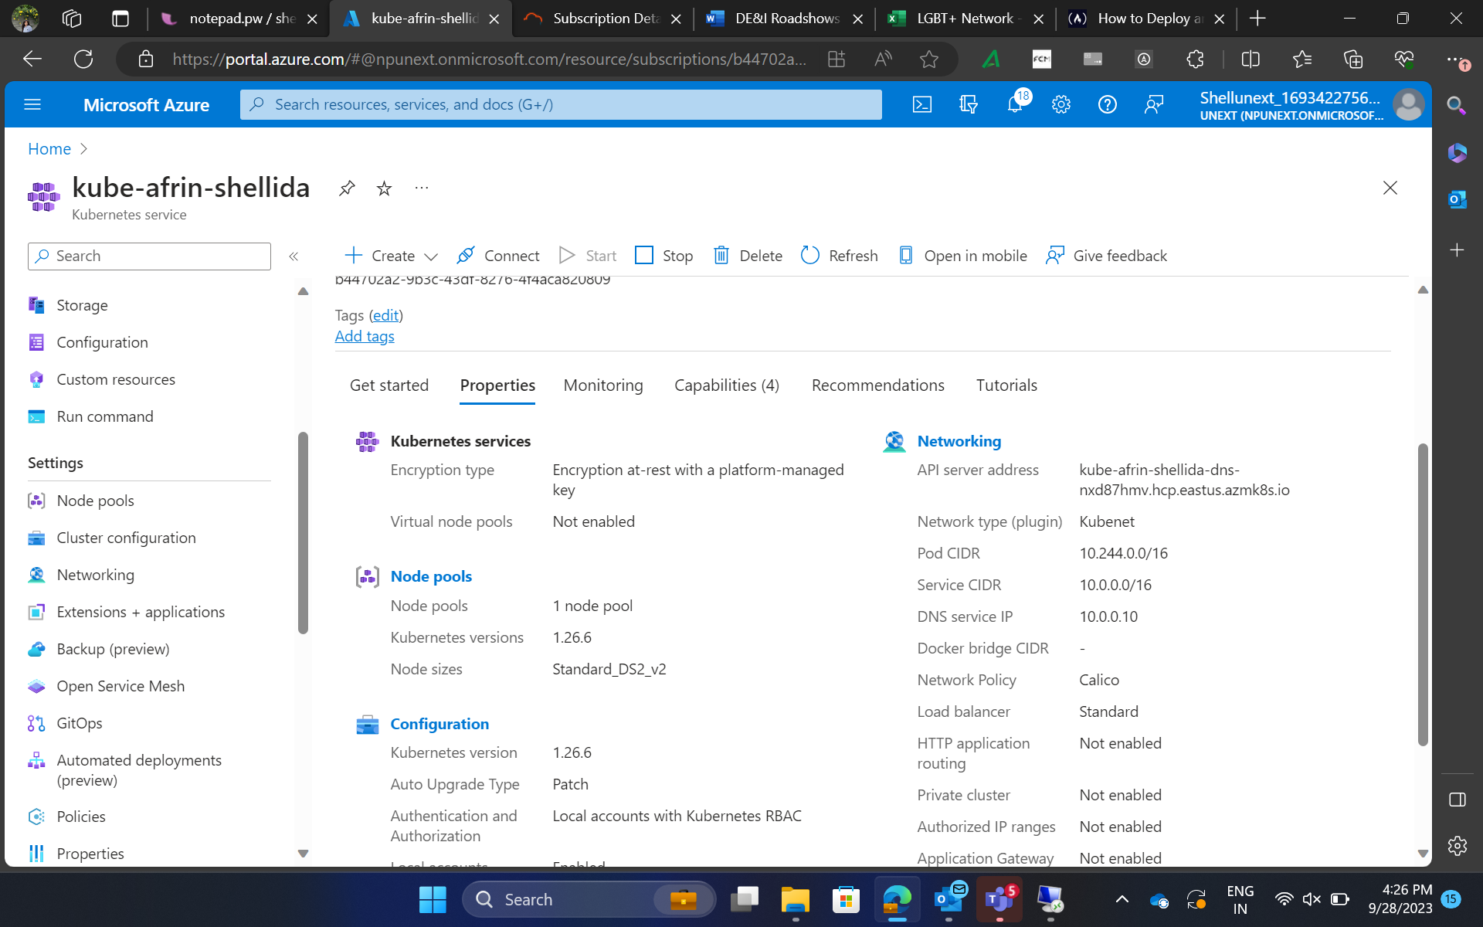
Day 5 – Hands on training/ Practical Work

Slide 14


